Slide 1
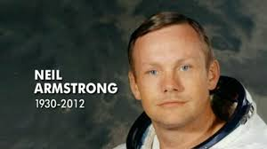
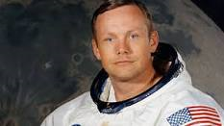
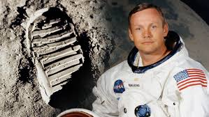
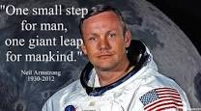
Neil Armstrong
By
Lance

Slide 2
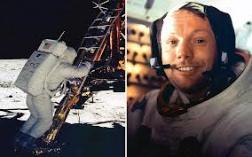
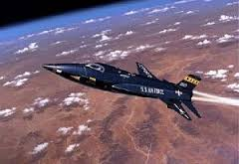
Early life
Born in Oklahoma City, Oklahoma August 13,1930
Married to Janet Shearon
He flew in the Tin Goose.
He liked airplanes.
He worked as a x-15 pilot.
He made balso wood airplanes.

Slide 3
About the parents
There names, Steven and Viola
Steven was his father.
Viola was his mother.

Slide 4
Moon Landing
Neil and Buzz went into the landing pod (Eagle).
Michal stayed inside the control module (Columbia).
Neil was the first one out of the Eagle.
Neil and Buzz got into there moon buggy and went for a drive.
Neil took a American flag out of the leg of the Eagle and drove it into the moon`s surface.

Slide 5
Later in Life
After going to the moon, Neil Armstrong became a teacher at Purdue University.
Neil died April 1, 2012.
He died at the age of 84.
He had heart problems and died from heart surgery complications.

Slide 6
Resources
Dunham, Montrew. The Childhood of Famous American Series: Neil Armstrong, Young Flyer. 1996. Aladdin Paperbacks. Print
www.biography.com

